Slide 1

Chapter 34 Menus, Toolbars, and Dialogs

Slide 2
Objectives
· To create menus using components JMenuBar, JMenu, JMenuItem, JCheckBoxMenuItem, and JRadioButtonMenuItem (§34.2).
To create popup menus using components JPopupMenu, JMenuItem, JCheckBoxMenuItem, and JRadioButtonMenuItem (§34.3).
To use JToolBar to create tool bars (§34.4).
To use Action objects to generalize the code for processing actions (§34.5).
To create standard dialogs using the JOptionPane class (§34.6).
To extend the JDialog class to create custom dialogs (§34.7).
To select colors using JColorChooser (§34.8).
To use JFileChooser to display Open and Save File dialogs (§34.9).

Slide 3
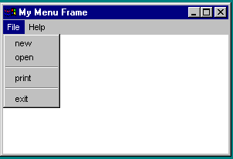
Menus
Java provides several classes—JMenuBar, JMenu, JMenuItem, JCheckBoxMenuItem, and JRadioButtonMenuItem —to implement menus in a frame.
A JFrame or JApplet can hold a menu bar to which the pull-down menus are attached. Menus consist of menu items that the user can select (or toggle on or off). Menu bars can be viewed as a structure to support menus.

Slide 4
The JMenuBar Class
A menu bar holds menus; the menu bar can only be added to a frame. Following is the code to create and add a JMenuBar to a frame:
JFrame f = new JFrame();
f.setSize(300, 200);
f.setVisible(true);
JMenuBar mb = new JMenuBar(); f.setJMenuBar(mb);

Slide 5
The JMenu Class
You attach menus onto a JMenuBar. The following code creates two menus, File and Help, and adds them to the JMenuBar mb:
JMenu fileMenu = new JMenu("File", false);
JMenu helpMenu = new JMenu("Help", true);
mb.add(fileMenu);
mb.add(helpMenu);

Slide 6
The JMenuItem Class
You add menu items on a menu. The following code adds menu items and item separators in
menu fileMenu:
fileMenu.add(new JMenuItem("new"));
fileMenu.add(new JMenuItem("open"));
fileMenu.addSeparator();
fileMenu.add(new JMenuItem("print"));
fileMenu.add(new JMenuItem("exit"));
fileMenu.addSeparator();

Slide 7
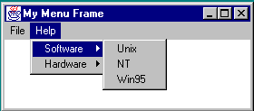
Submenus
You can add submenus into menu items. The following code adds the submenus “Unix,” “NT,” and “Win95” into the menu item “Software.”
JMenu softwareHelpSubMenu = new JMenu("Software");
JMenu hardwareHelpSubMenu = new JMenu("Hardware");
helpMenu.add(softwareHelpSubMenu);
helpMenu.add(hardwareHelpSubMenu);
softwareHelpSubMenu.add(new JMenuItem("Unix"));
softwareHelpSubMenu.add(new JMenuItem("NT"));
softwareHelpSubMenu.add(new JMenuItem("Win95"));

Slide 8
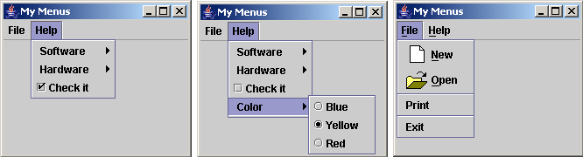
Check Box Menu Items
helpMenu.add(new JCheckBoxMenuItem("Check it"));

Slide 9
Radio Button Menu Items
JMenu colorHelpSubMenu = new JMenu("Color");
helpMenu.add(colorHelpSubMenu);
JRadioButtonMenuItem jrbmiBlue, jrbmiYellow, jrbmiRed;
colorHelpSubMenu.add(jrbmiBlue = new JRadioButtonMenuItem("Blue"));
colorHelpSubMenu.add(jrbmiYellow = new JRadioButtonMenuItem("Yellow"));
colorHelpSubMenu.add(jrbmiRed = new JRadioButtonMenuItem("Red"));
ButtonGroup btg = new ButtonGroup();
btg.add(jrbmiBlue);
btg.add(jrbmiYellow);
  btg.add(jrbmiRed);

Slide 10
Radio Button Menu Items
JMenu colorHelpSubMenu = new JMenu("Color");
helpMenu.add(colorHelpSubMenu);
JRadioButtonMenuItem jrbmiBlue, jrbmiYellow, jrbmiRed;
colorHelpSubMenu.add(jrbmiBlue = new JRadioButtonMenuItem("Blue"));
colorHelpSubMenu.add(jrbmiYellow = new JRadioButtonMenuItem("Yellow"));
colorHelpSubMenu.add(jrbmiRed = new JRadioButtonMenuItem("Red"));
ButtonGroup btg = new ButtonGroup();
btg.add(jrbmiBlue);
btg.add(jrbmiYellow);
  btg.add(jrbmiRed);

Slide 11
Image Icons, Keyboard Mnemonics, and Keyboard Accelerators
JMenuItem jmiNew, jmiOpen;
fileMenu.add(jmiNew = new JMenuItem("New"));
fileMenu.add(jmiOpen = new JMenuItem("Open"));
jmiNew.setIcon(new ImageIcon("image/new.gif"));
jmiOpen.setIcon(new ImageIcon("image/open.gif"));
helpMenu.setMnemonic('H');
fileMenu.setMnemonic('F');
jmiNew.setMnemonic('N');
jmiOpen.setMnemonic('O');
jmiOpen.setAccelerator(KeyStroke.getKeyStroke(KeyEvent.VK_O, ActionEvent.CTRL_MASK));

Slide 12
Example: Using Menus
Objective: Create a user interface that performs arithmetic. The interface contains labels and text fields for Number 1, Number 2, and Result. The Result box displays the result of the arithmetic operation between Number 1 and Number 2.

Slide 13
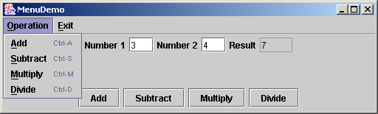
Example: Using Menus
Problem: Create a user interface that performs arithmetic. The interface contains labels and text fields for Number 1, Number 2, and Result. The Result box displays the result of the arithmetic operation between Number 1 and Number 2.
MenuDemo
Run

Slide 14
Popup Menus
A popup menu, also known as a context menu, is like a regular menu, but does not have a menu bar and can float anywhere on the screen. Creating a popup menu is similar to creating a regular menu. First, you create an instance of JPopupMenu, then you can add JMenuItem, JCheckBoxMenuItem, JradioButtonMenuItem, and separators to the popup menu. For example, the following code creates a JPopupMenu and adds JMenuItems into it:
JPopupMenu jPopupMenu = new JPopupMenu();
JPopupMenu(new JMenuItem("New"));
JPopupMenu(new JMenuItem("Open"));

Slide 15
Displaying a Popup Menu
A regular menu is always attached to a menu bar using the setJMenuBar method, but a popup menu is associated with a parent component and is displayed using the show method in the JPopupMenu class. You specify the parent component and the location of the popup menu, using the coordinate system of the parent like this:
  jPopupMenu.show(component, x, y);

Slide 16
Popup Trigger
The popup menu usually contains the commands for an object. Customarily, you display a popup menu by pointing to the object and clicking a certain mouse button, the so-called popup trigger. Popup triggers are system-dependent. In Windows, the popup menu is displayed when the right mouse button is released. In Motif, the popup menu is displayed when the third mouse button is pressed and held down.

Slide 17
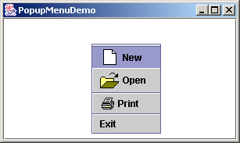
Example: Using Popup Menus
Problem: The program creates a text area in a scroll pane. The popup menu is displayed when the mouse pointed to the text area triggers the popup menu.
PopupMenuDemo
Run

Slide 18
JToolBar
In user interfaces, a toolbar is often used to hold commands that also appear in the menus. Frequently used commands are placed in a toolbar for quick access. Clicking a command in the toolbar is faster than choosing it from the menu.
Swing provides the JToolBar class as the container to hold tool bar components. JToolBar uses BoxLayout to manage components by default. You can set a different layout manager if desired. The components usually appear as icons. Since icons are not components, they cannot be placed into a tool bar directly. Instead you may place buttons into the tool bar and set the icons on the buttons. An instance of JToolBar is like a regular container. Often it is placed in the north, west, or east of a container of BorderLayout.

Slide 19
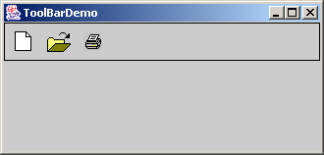
Example: Using Tool Bars
Problem: Create a JToolBar that contains three buttons with the icons representing the commands New, Open, and Print icons.
ToolBarDemo
Run

Slide 20
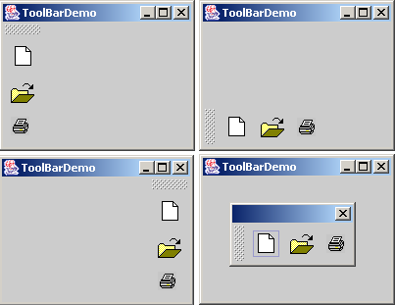
Floatable Tool Bars
JToolBar may be floatable.

Slide 21
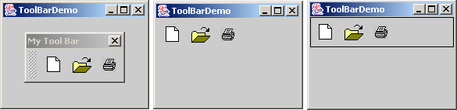
Tool Bars Title and Border
You can set a title for the floatable tool bar.
If you set floatable false, the flotable controller is not displayed
If you set floatable false, the flotable controller is not displayed

Slide 22
Processing Actions Using the Action Interface
Often menus and tool bars contain some common actions. For example, you can save a file by choosing File, Save, or by clicking the save button in the tool bar. Swing provides the Action interface, which can be used to create action objects for processing actions. Using Action objects, common action processing can be centralized and separated from the other application code.

Slide 23
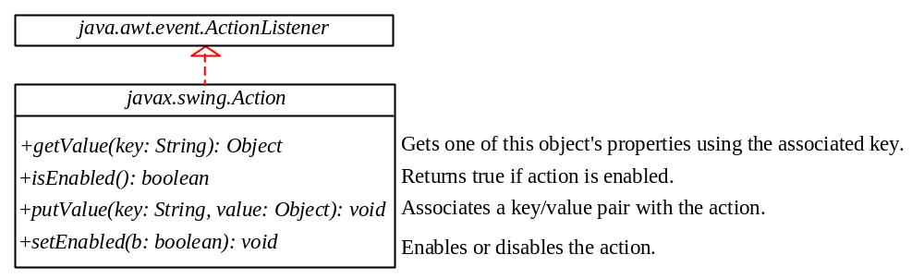
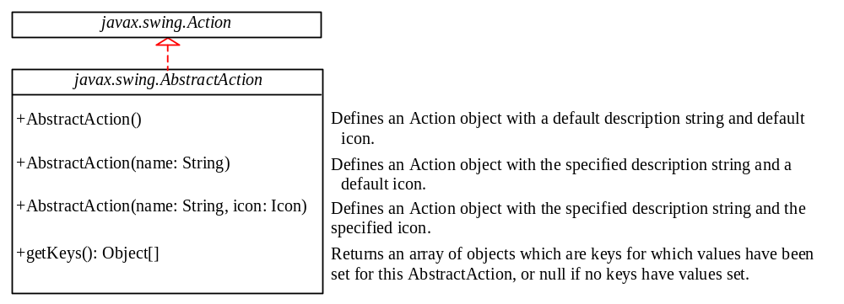
ActionListener, Action, and AbstractAction
The Action interface provides a useful extension to the ActionListener interface in cases where the same functionality may be accessed by several controls
AbstractAction class provides a default implementation for Action

Slide 24
Creating and Using an Action instance
  Action exitAction = new AbstractAction("Exit") {
  public void actionPerformed(ActionEvent e) {
  System.exit(0);
  }
  };
Certain containers, such as JMenu and JToolBar, know how to add an Action object. When an Action object is added to such a container, the container automatically creates an appropriate component for the Action object, and registers a listener with the Action object. Here is an example of adding an Action object to a menu and a tool bar:
  jMenu.add(exitAction);
  jToolBar.add(exitAction);

Slide 25
Associating Action instances with Buttons
Several Swing components such as JButton, JRadioButton, and JCheckBox contain constructors to create instances from Action objects. For example, you can create a JButton from an Action object, as follows:
  JButton jbt = new JButton(exitAction);

Slide 26
Associating Action instances with Keystrokes
Action objects can also be used to respond to keystrokes. To associate actions with keystrokes, you need to create an instance of the KeyStroke class using the static getKeyStroke method, as follows:
    KeyStroke exitKey =
    KeyStroke.getKeyStroke(KeyEvent.VK_E, KeyEvent.CTRL_MASK);
You can now associate an action with the keystroke by registering it with an instance of JComponent. For example, the following code associates exitAction with exitKey, and registers this action with jPanel1.
    jPanel1.registerKeyboardAction
    (exitAction, exitKey, Component.WHEN_IN_FOCUSED_WINDOW);

Slide 27
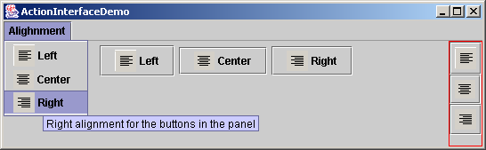
Example: Using Actions
Problem: Write a program that creates three menu items, Left, Center, and Right, three tool bar buttons, Left, Center, and Right, and three regular buttons, Left, Center, and Right in a panel. The panel that holds the buttons uses the FlowLayout. The action of the left, center, and right button sets the alignment of the FlowLayout to left, right, and center, respectively.
ActionInterfaceDemo
Run

Slide 28
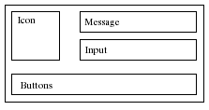
JOptionPane Dialogs
A dialog is normally used as a temporary window to receive additional information from the user, or to provide notification that some event has occurred. Java provides the JOptionPane class, which can be used to create standard dialogs. You can also build custom dialogs by extending the JDialog class.
A JOptionPane dialog can display an icon, a message, an input, and option buttons.

Slide 29
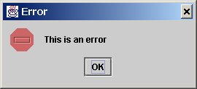
Message Dialogs
A message dialog box simply displays a message to alert the user and waits for the user to click the OK button to close the dialog.
JOptionPane.showMessageDialog(null, “This is an error",
“Error", JOptionPane.INFORMATION_MESSAGE);

Slide 30
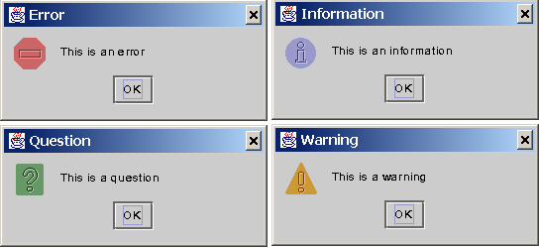
Message Types
The messageType is one of the following constants:
  JOptionPane.ERROR_MESSAGE
  JOptionPane.INFORMATION_MESSAGE
  JOptionPane.PLAIN_MESSAGE
  JOptionPane.WARNING_MESSAGE
  JOptionPane.QUESTION_MESSAGE

Slide 31
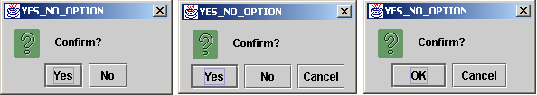
Confirmation Dialogs
A message dialog box displays a message and waits for the user to click the OK button to dismiss the dialog. The message dialog does not return any value. A confirmation dialog asks a question and requires the user to respond with an appropriate button. The confirmation dialog returns a value that corresponds to a selected button.

Slide 32
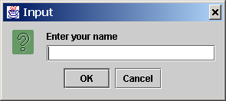
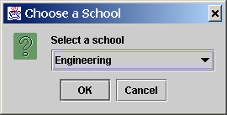
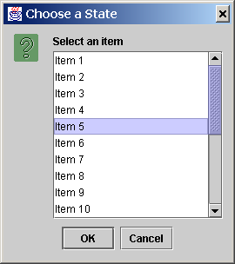
Input Dialogs
An input dialog box is used to receive input from the user. The input can be entered from a text field or selected from a combo box or a list. Selectable values can be specified in an array, and a particular value can be designated as the initial selected value.

Slide 33
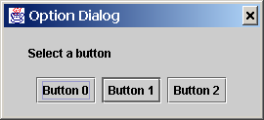
Option Dialogs
An option dialog allows you to create custom buttons.

Slide 34
Example: Creating JOptionPane Dialogs
Problem: This example demonstrates using standard dialogs. The program prompts the user to select the annual interest rate from a list in an input dialog, the number of years from a combo box in an input dialog, and the loan amount from an input dialog, and displays the loan payment schedule in a text area inside a JScrollPane in a message dialog.

Slide 35
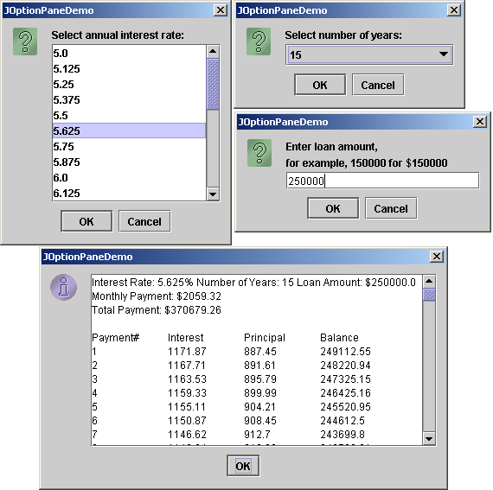
Example: Creating JOptionPane Dialogs, cont.
JOptionPaneDemo
Run

Slide 36
Creating Custom Dialogs
In Swing, the JDialog class can be extended to create custom dialogs.
JDialog is a subclass of java.awt.Dialog fitted with an instance of JRootPane. As with JFrame, components are added to the contentPane of JDialog. Creating a custom dialog usually involves laying out user interface components in the dialog, adding buttons for dismissing the dialog, and installing listeners that respond to button actions.

Slide 37
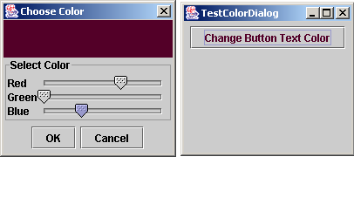
Example: Creating Custom Dialogs
Problem: Create a custom dialog box for choosing colors, as shown in Figure 34.18 (a). Use this dialog to choose the color for the foreground for the button, as shown in Figure 34.18 (b).
ColorDialog
TestColorDialog
Run

Slide 38
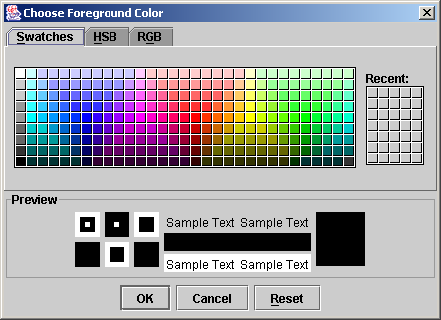
JColorChooser
Color dialogs are commonly used in GUI programming. Swing provides a convenient and versatile color dialog named javax.swing.JColorChooser. Like JOptionPane, JColorChooser is a lightweight component inherited from JComponent. It can be added to any container.

Slide 39
Using JColorChooser
To create a JColorChooser, use
  new JColorChooser();
To display a JColorChooser dialog box, use
  public static Color showDialog(Component parentComponent,
  String title, Color initialColor)
This method creates an instance of JDialog with three buttons, OK, Cancel, and Reset, to hold a JColorChooser object, as shown in Figure 34.27. The method displays a modal dialog. If the user clicks the OK button, the method dismisses the dialog and returns the selected color. If the user clicks the Cancel button or closes the dialog, the method dismisses the dialog and returns null.

Slide 40
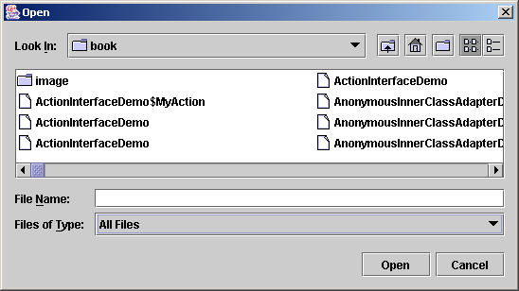
JFileChooser
Swing provides the javax.swing.JFileChooser class that displays a dialog box from which the user can navigate through the file system and select files for loading or saving.

Slide 41
Using JFileChooser
Creating a JFileChooser: Using JFileChooser's no-arg constructor.
Displaying an Open File Dialog:
  The file dialog box can appear in two types: open and save. The open type is for opening a file, and the save type is for storing a file. To create an open file dialog, use the following method:
    public int showOpenDialog(Component parent)
  This method creates a dialog box that contains an instance of JFileChooser for opening a file. The method returns an int value, either APPROVE_OPTION or CANCEL_OPTION, which indicates whether the OK button or the Cancel button was clicked.
Displaying a Save File Dialog:
    public int showSaveDialog(Component parent)

Slide 42
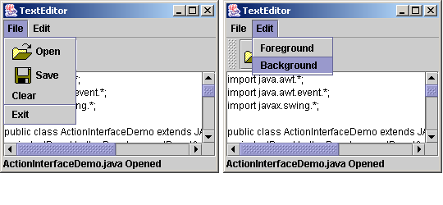
Example: Creating a Text Editor
Problem: This example uses Swing menus, tool bar, file chooser, and color chooser to create a simple text editor, as shown in Figure 34.23, which allows the user to open and save text files, clear text, and change the color and font of the text.
TextEditor
Run

Slide 43
Creating Internal Frames
Companion Website
The JInternalFrame class is almost the same as the external JFrame class. The components are added to the internal frame in the same way as they are added to the external frame. The internal frame can have menus, the title, the Close icon, the Minimize icon, and the Maximize icon just like the external frame.

Slide 44
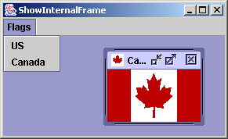
Example: Creating Internal Frames
Companion Website
Problem: This example creates internal frames to display flags in an applet. You can select flags from the Flags menu. Clicking a menu item causes a flag to be displayed in an internal frame.
ShowInternalFrame
Run

